Slide 1
Numeral system
1 주-1/2

Slide 2
길이 : 농경사회에 필요
크기
역사적 길이
면적
부피
Logarithm
고대인의 수 계산방법

Slide 3
수 number
2 진법 :
8 진법 :
10 진법 :
12 진법 :
16 진법 :
20 진법 : Maya, France
프랑스어 숫자 표현
https://m.blog.naver.com/PostView.nhn?blogId=eunkoreah1&logNo=45005425&proxyReferer=https%3A%2F%2Fwww.google.com%2F
60 진법 : Babylonia
60 진법
https://www.youtube.com/watch?v=xbFJeYSKfoo
https://www.youtube.com/watch?v=FxTencmpDLc
Sqrt(2) 값을 계산
https://www.youtube.com/watch?v=J5Ug3Cr8RUE
(r^2-s^2)^2+(2rs)^2=(r^2+s^2)^2 (Euclid)를 바빌로니아 수 체계로 설명
https://www.youtube.com/watch?v=9o1FlKc_3aM

Slide 4
360 진법

Slide 5
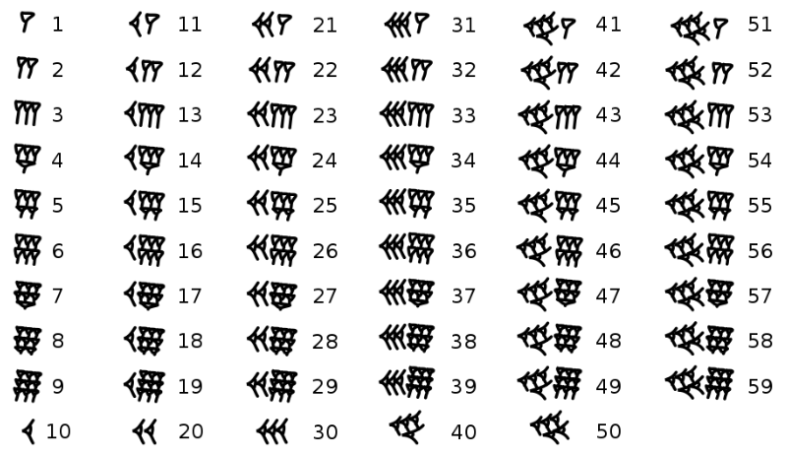
Babylonian cuneiform numerals (sexagesimal)
https://en.wikipedia.org/wiki/Sexagesimal

Slide 6
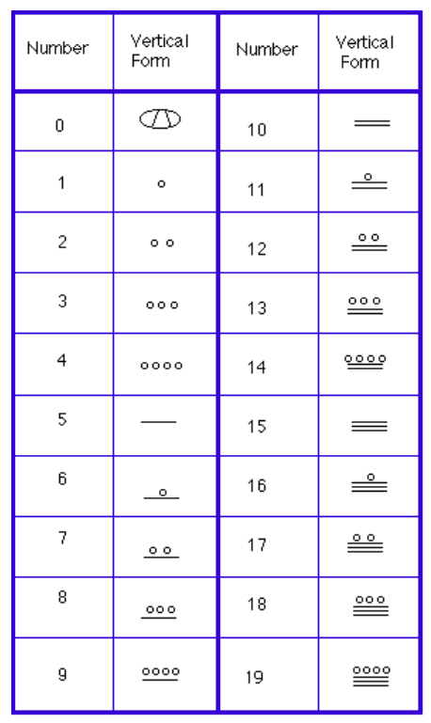
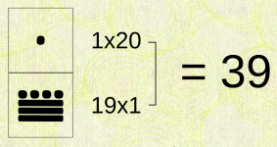
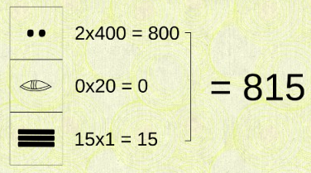
Mayan numeral system : vigesimal
https://courses.lumenlearning.com/waymakermath4libarts/chapter/the-mayan-numeral-system/
https://mayaarchaeologist.co.uk/2016/12/28/maya-numbers/ : 0의 사용!!!

Slide 7
Greek numbers
http://www.hellenicaworld.com/Greece/Science/en/Counting.html
Greek mathematics
https://www.youtube.com/watch?v=5cpH4ErtPjo
value | Name | Symbol
1 | Alpha | α
2 | Beta | β
3 | Gamma | γ
4 | Delta | δ
5 | Epsilon | ε
6 | Digamma | Ϝ
7 | Zeta | χ
8 | Eta | ε
9 | Theta | θ
10 | Iota | ι
20 | Kappa | κ
30 | Lambda | λ
40 | Mu | μ
50 | Nu | ν
value | Name | Symbol
60 | Xi | ξ
70 | Omicron | ο
80 | Pi | π
90 | Koppa | Ϙ
100 | Rho | ρ
200 | Sigma | σ
300 | Tau | τ
400 | Upsilon | υ
500 | Phi | π
600 | Chi | χ
700 | Psi | ψ
800 | Omega | ω
900 | sampi | Ϡ
ια = 11
ιβ = 12
ιγ = 13
ιδ = 14
ιε = 15
ισ = 16
ιζ = 17
ιη =18
ιθ = 19
σπζ = 287
^{ι}βτμζ = 2347 (1000 to 9999)

Slide 8
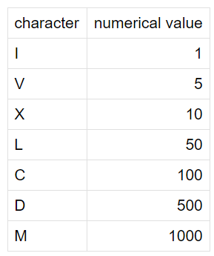
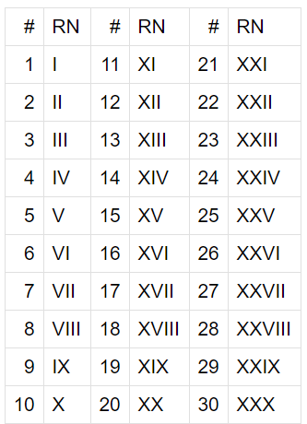
Roman numerals
http://mathworld.wolfram.com/RomanNumerals.html

Slide 9
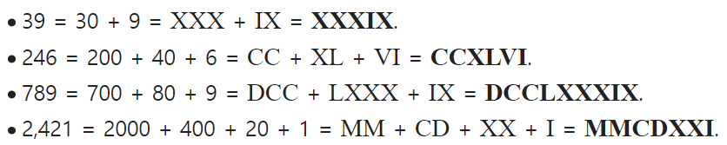
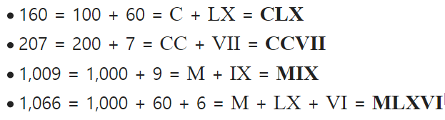
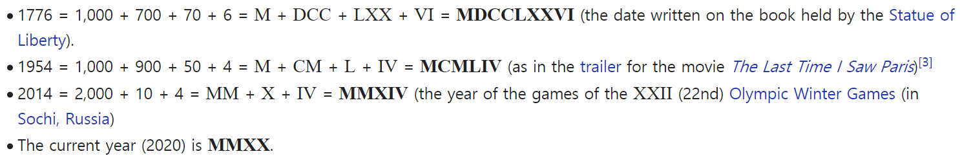
Roman numerals
https://en.wikipedia.org/wiki/Roman_numerals

Slide 10
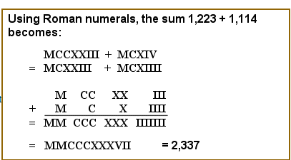
Roman mathematics
https://www.storyofmathematics.com/roman.html

Slide 11
0의 존재
인도

Slide 12
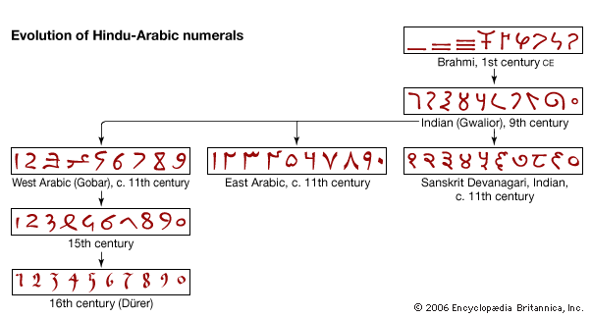
아라비아 숫자
완벽한 10 진수
https://www.youtube.com/watch?v=cZH0YnFpjwU
https://www.youtube.com/watch?v=19AzKtxG9NY
https://kids.britannica.com/kids/assembly/view/89478

Slide 13
고대 사회에서 수의 활용
천문
건축
농경
길이
면적
부피

Slide 14
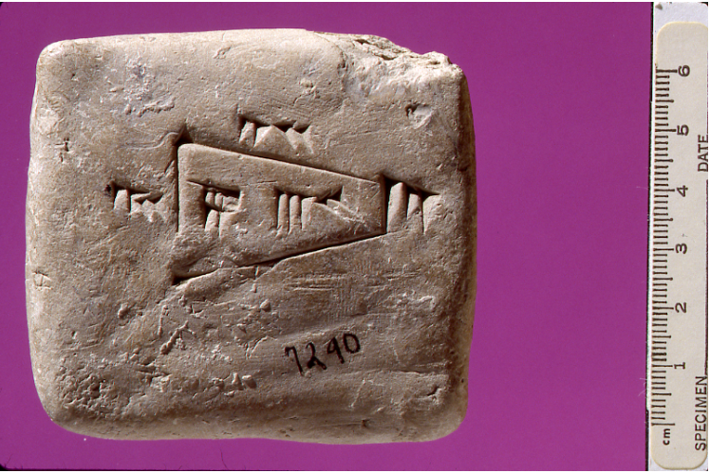
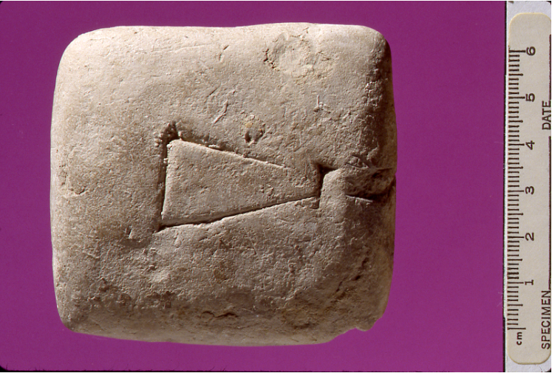
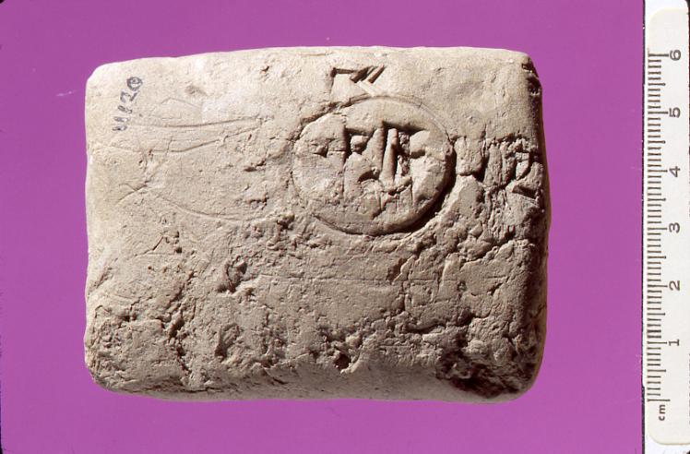
Old Babylonian area calculation
https://www.maa.org/press/periodicals/convergence/mathematical-treasure-old-babylonian-area-calculation

Slide 15
Ancient Egyptian form of multiplication
두 자리수의 곱
https://www.youtube.com/watch?v=yHVq0g6XWes&feature=emb_title
https://www.youtube.com/watch?v=qHXsKyVSPOU
복잡한 계산
https://www.youtube.com/watch?v=iZG25uBwU7M
Ancient Egyptian divided numbers
https://www.youtube.com/watch?v=bKqQGISplMo

Slide 16
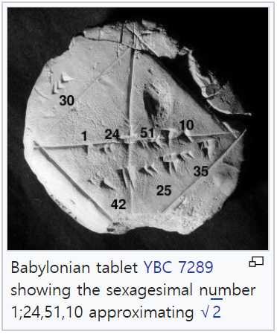

[25] Sexagesimal
https://en.wikipedia.org/wiki/Sexagesimal
HM-25-366-1998
[26] sexagenary cycle
https://en.wikipedia.org/wiki/Sexagenary_cycle
한글 자료 : https://namu.wiki/w/%EC%9C%A1%EC%8B%AD%EA%B0%91%EC%9E%90

Slide 17
중국 sexagenary cycle
https://en.wikipedia.org/wiki/Sexagenary_cycle
한글 자료 : https://namu.wiki/w/%EC%9C%A1%EC%8B%AD%EA%B0%91%EC%9E%90

Slide 18
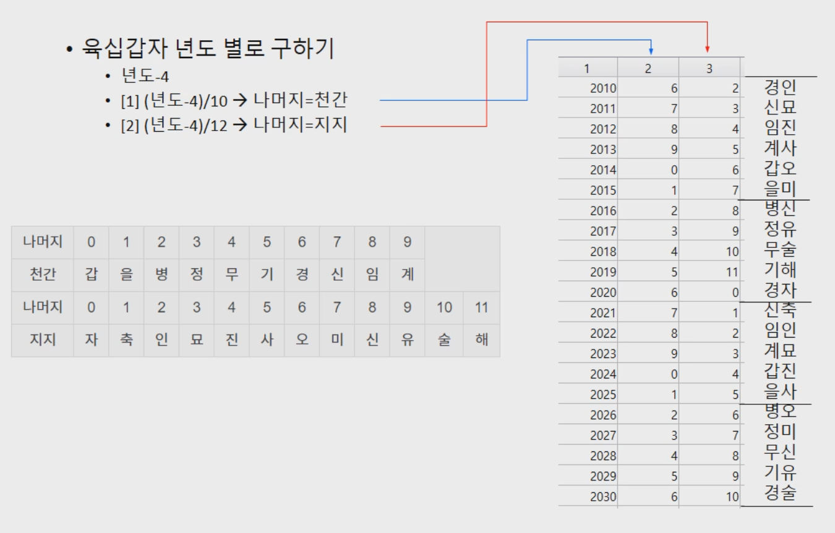

Slide 19
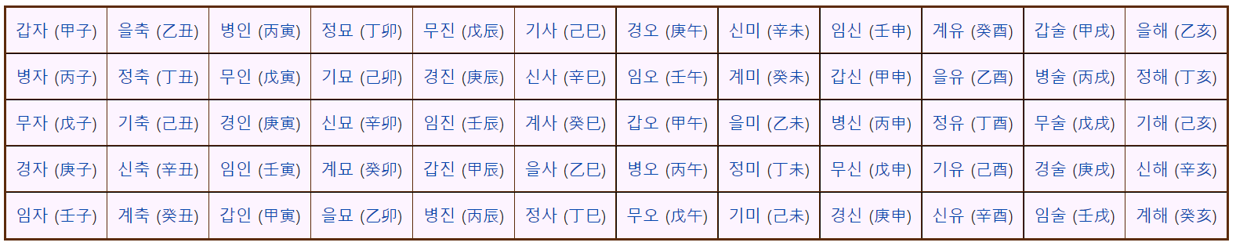
육십갑자

Slide 20
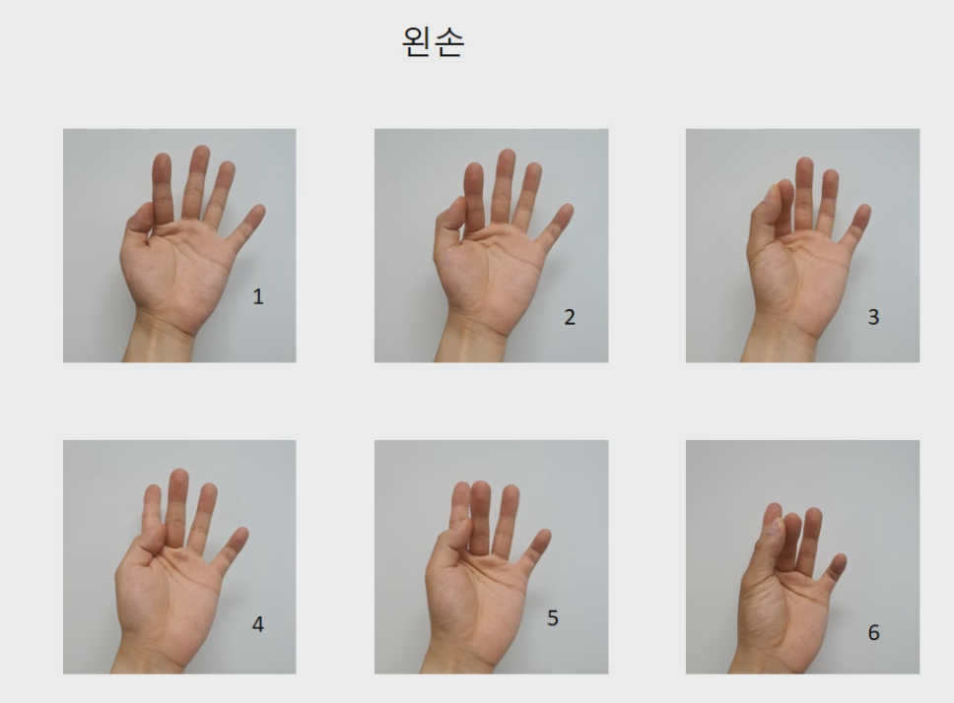

Slide 21
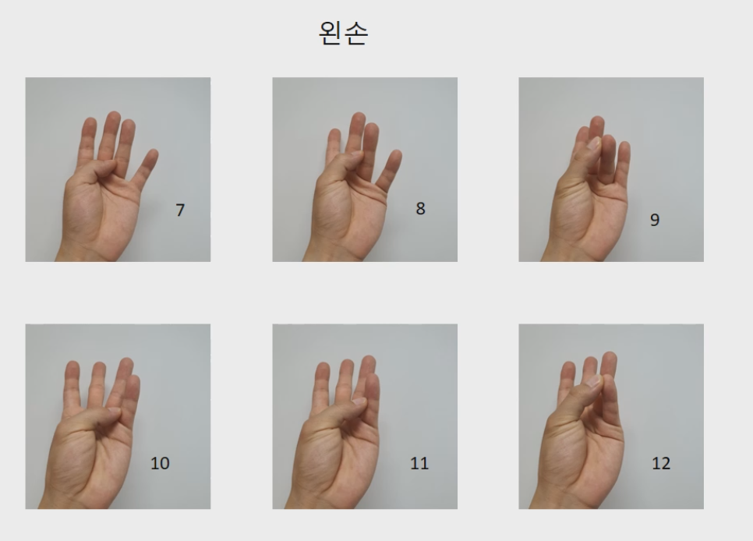

Slide 22
